Slide 1
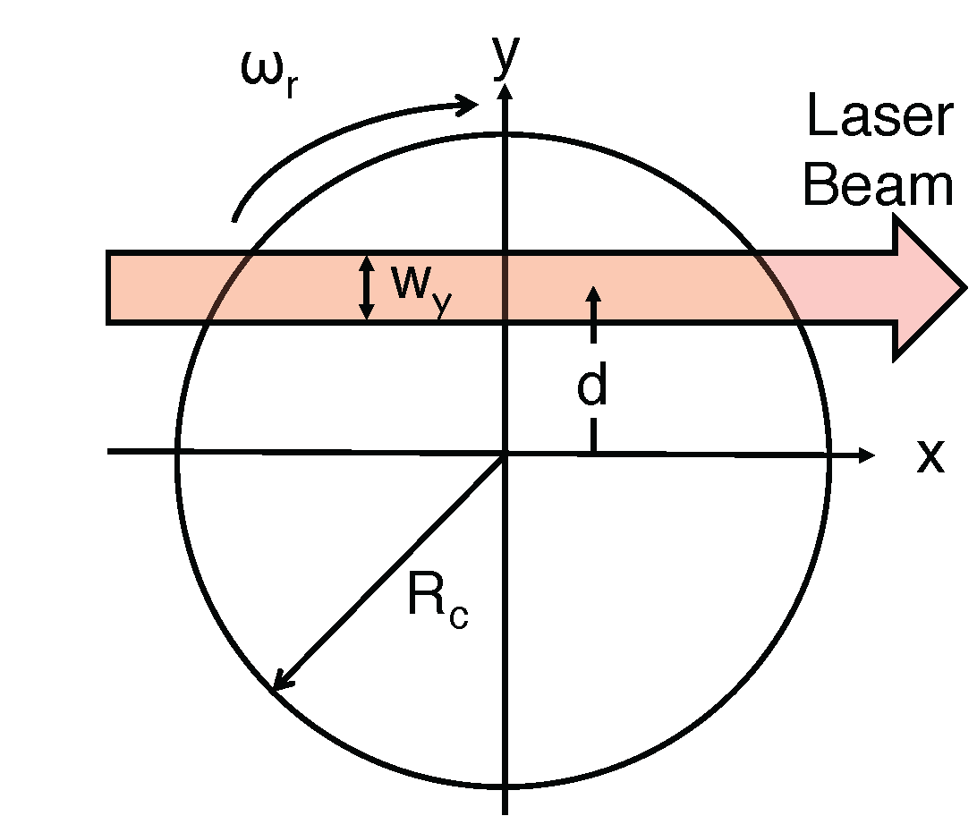
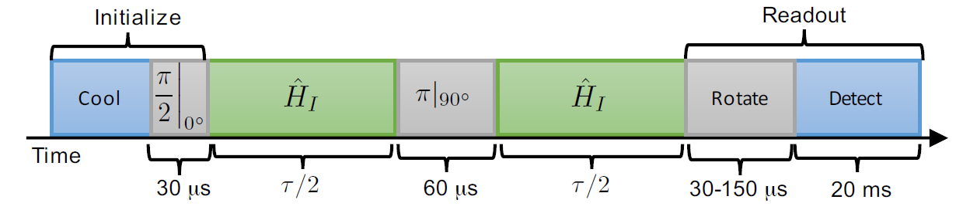
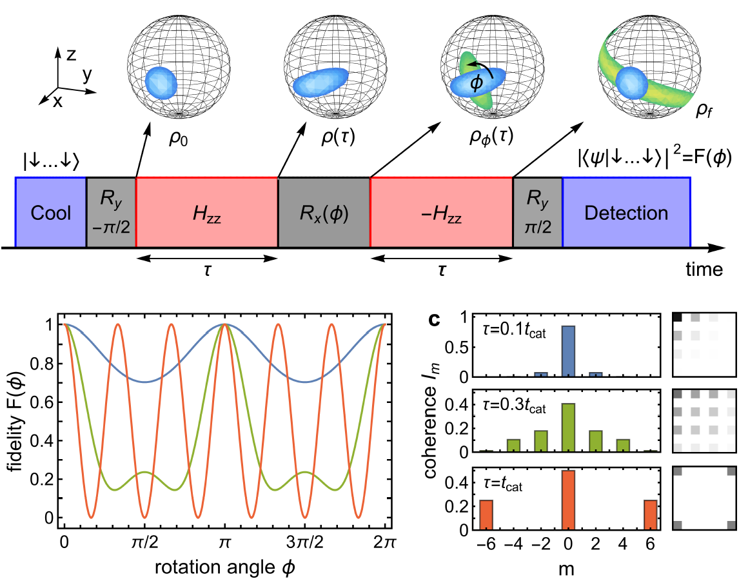
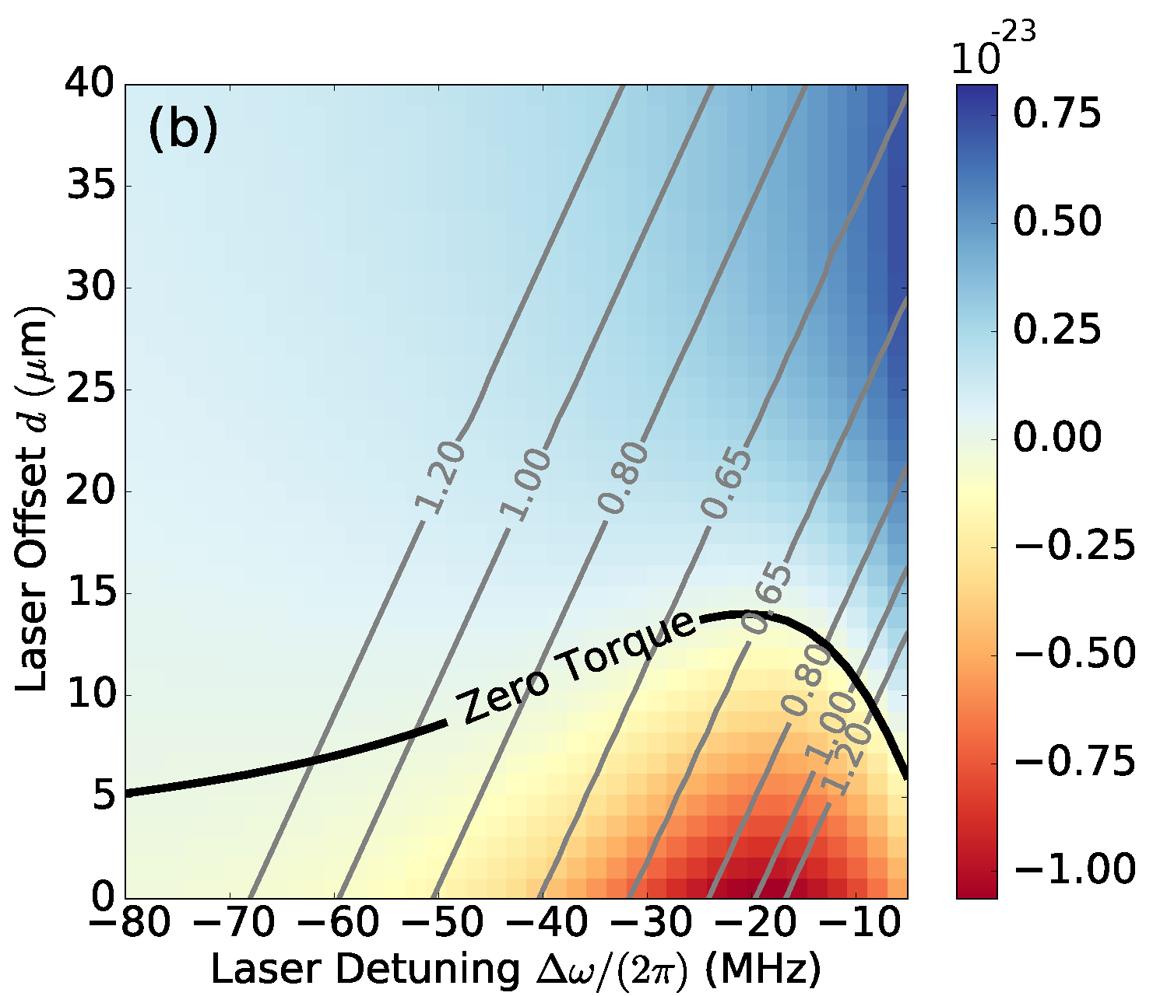
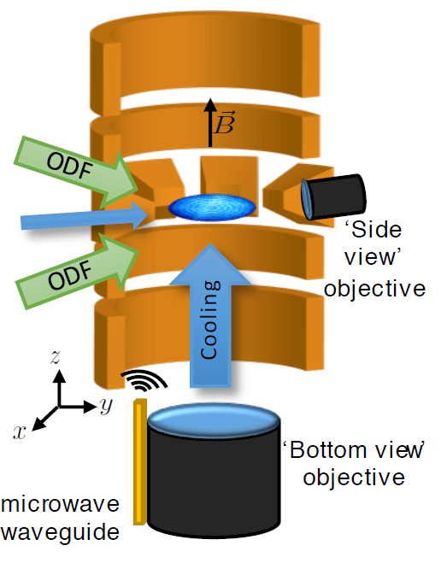
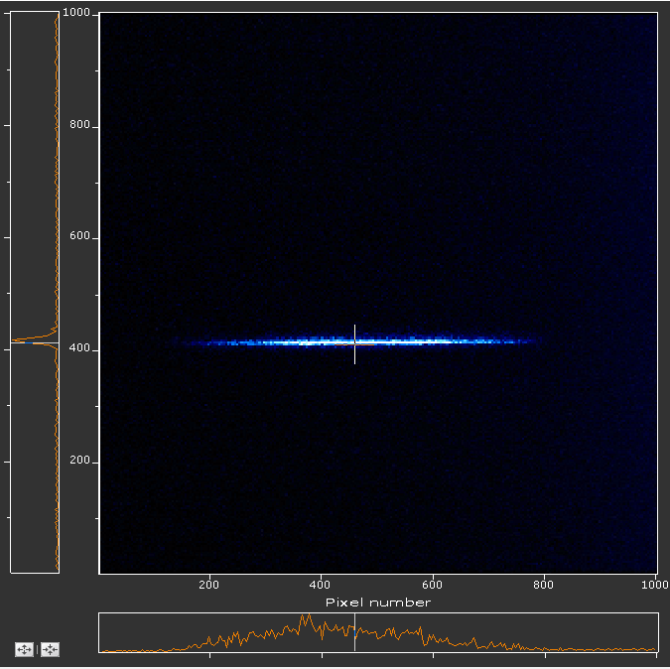
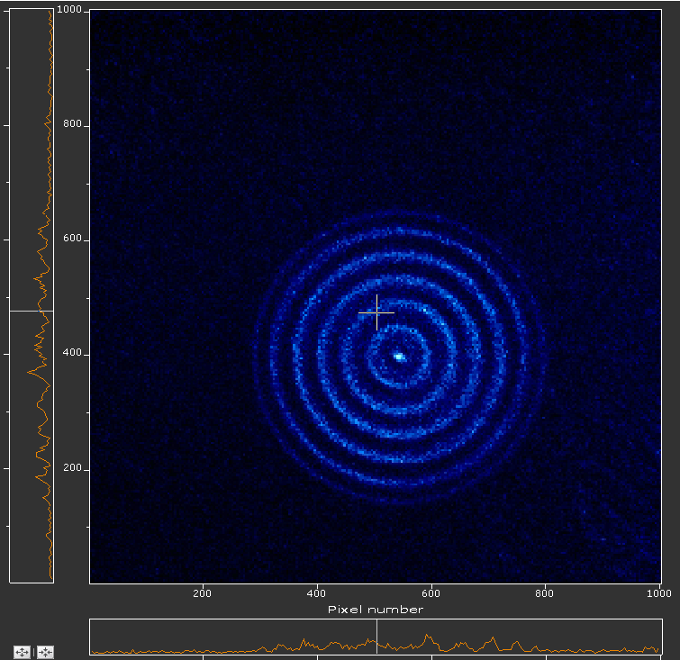
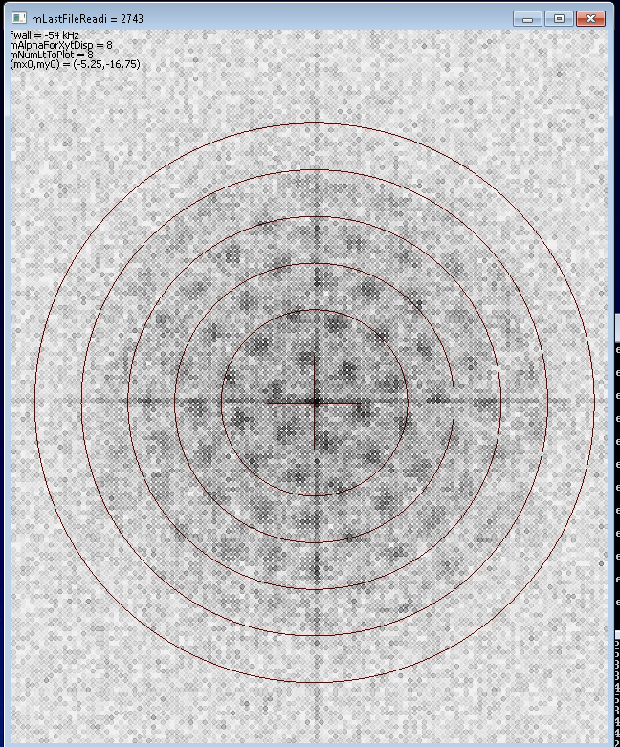
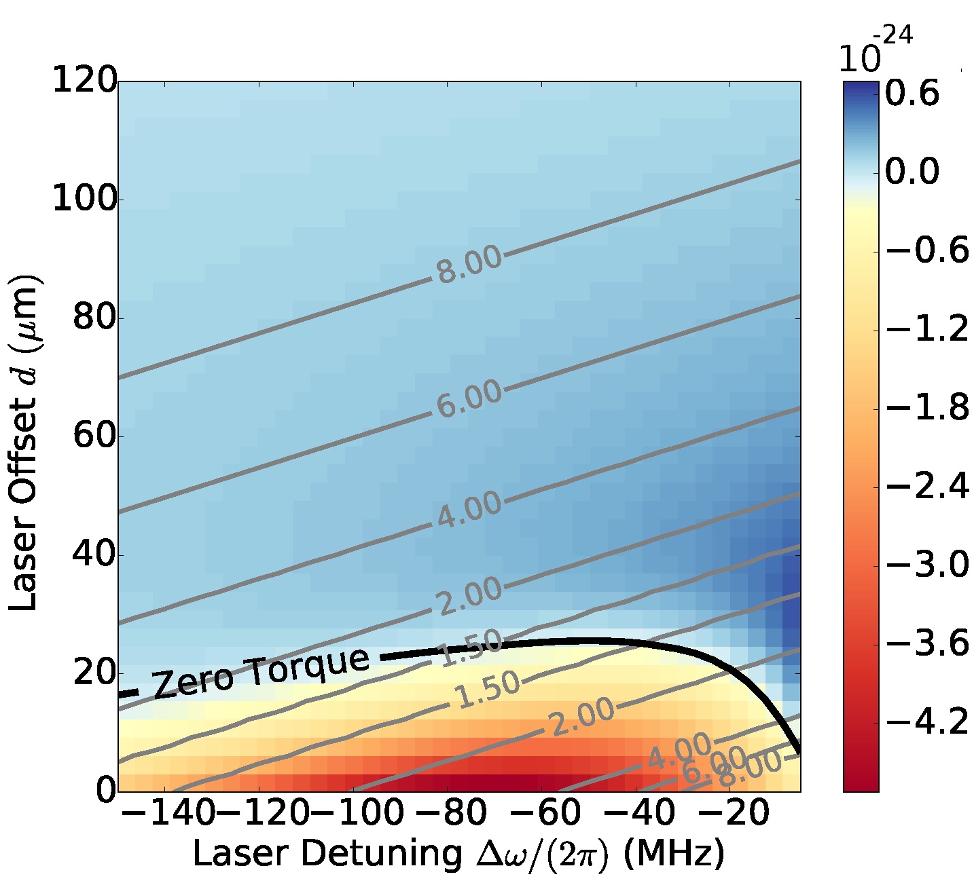
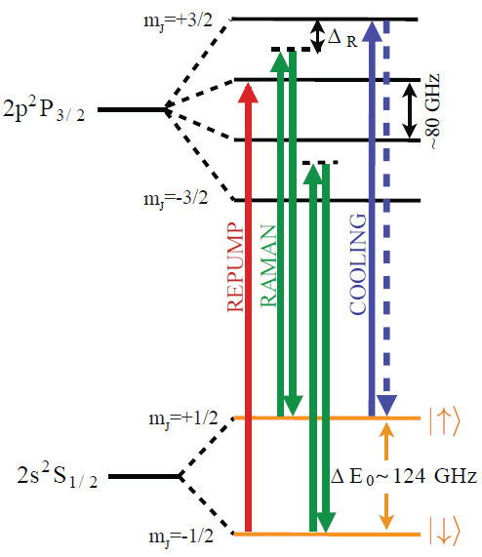
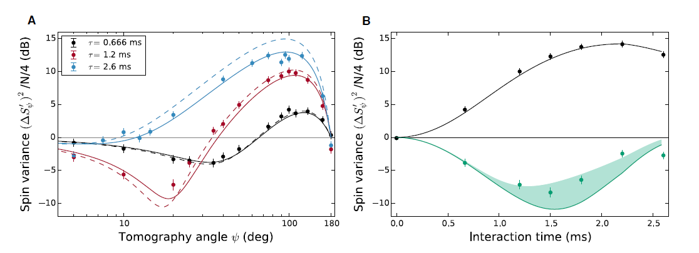
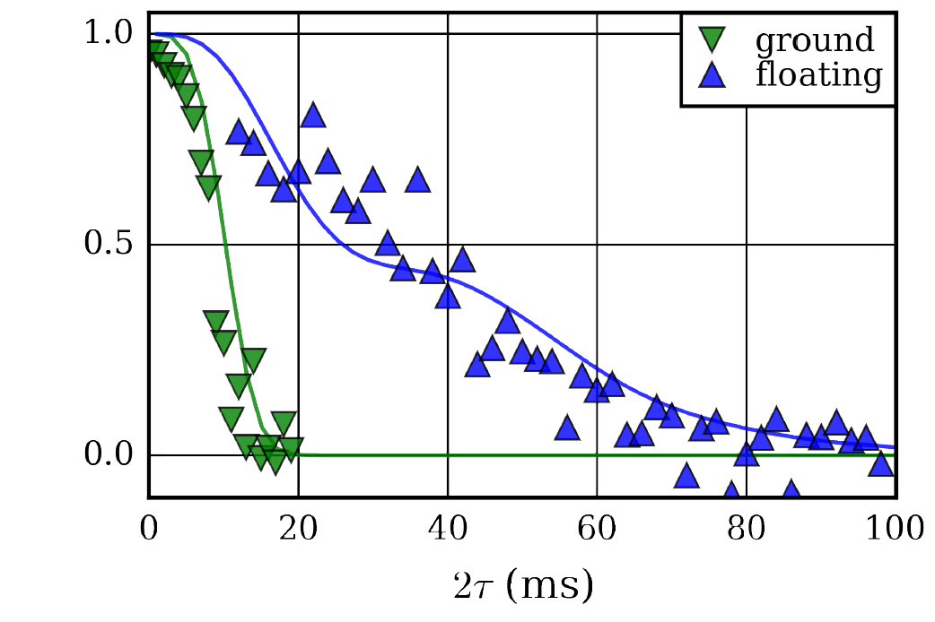
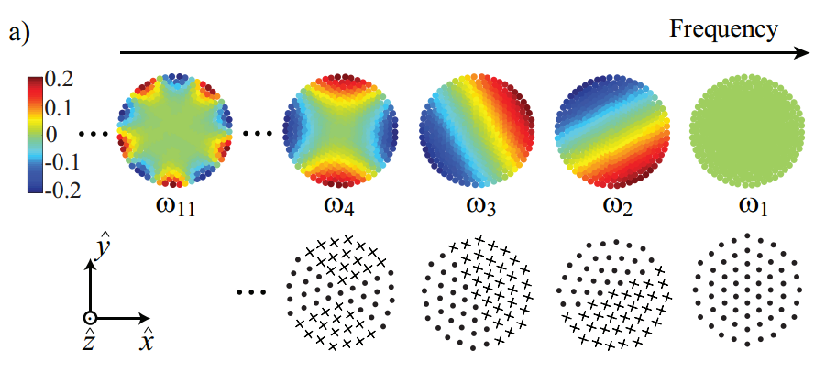
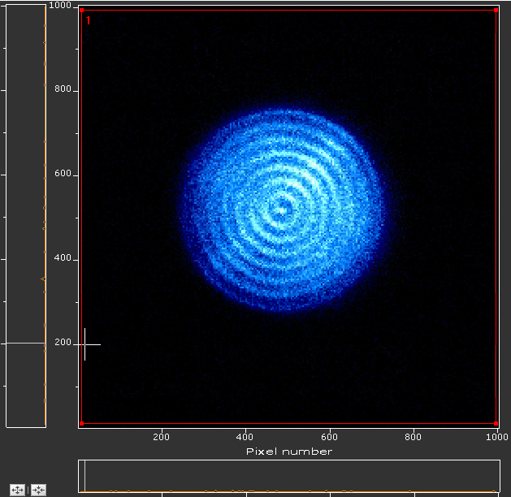
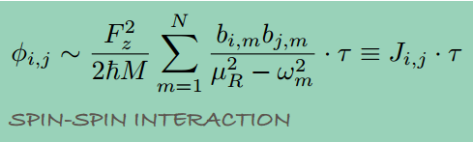
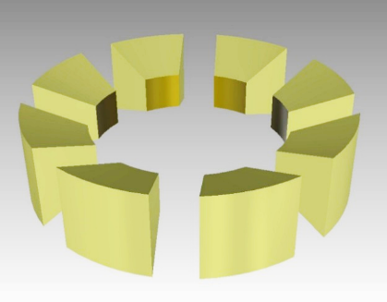
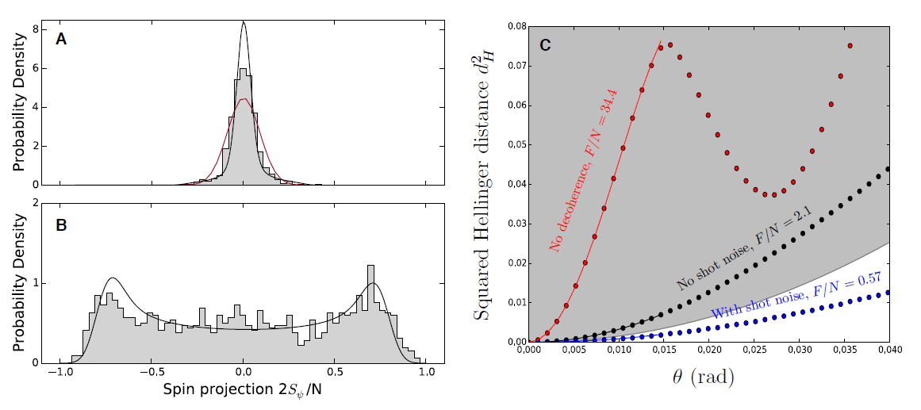
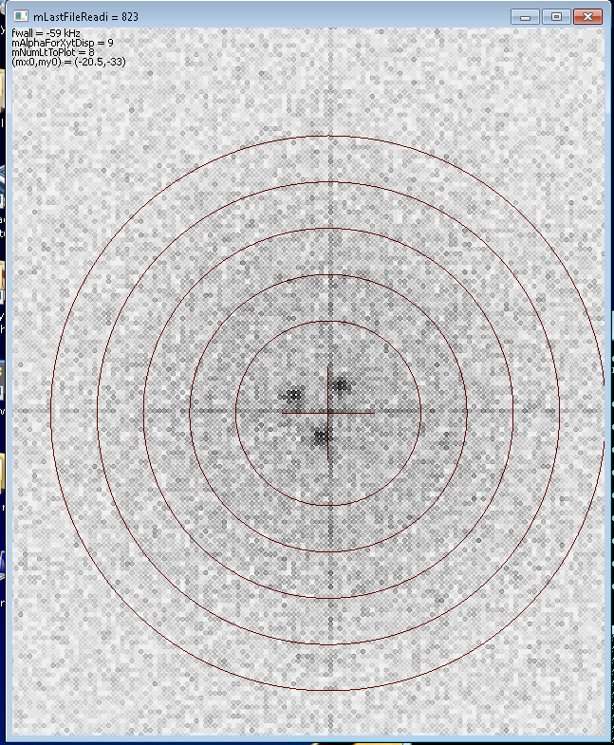
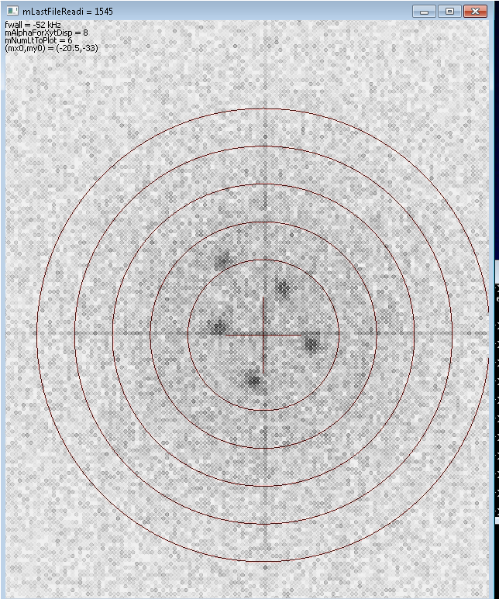
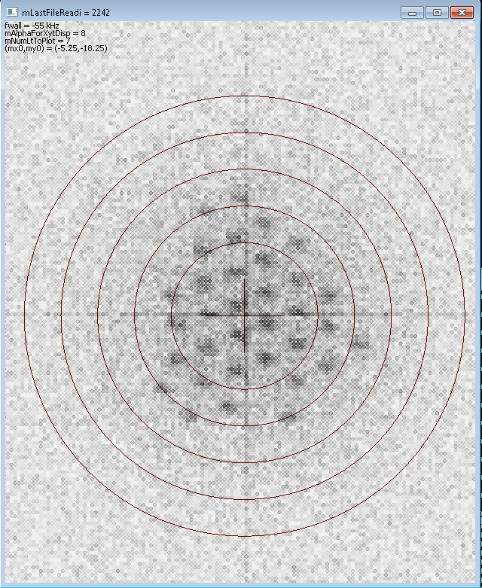
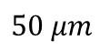
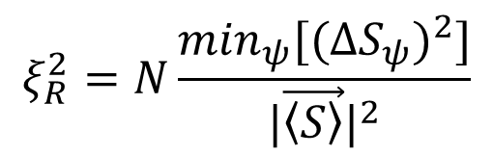
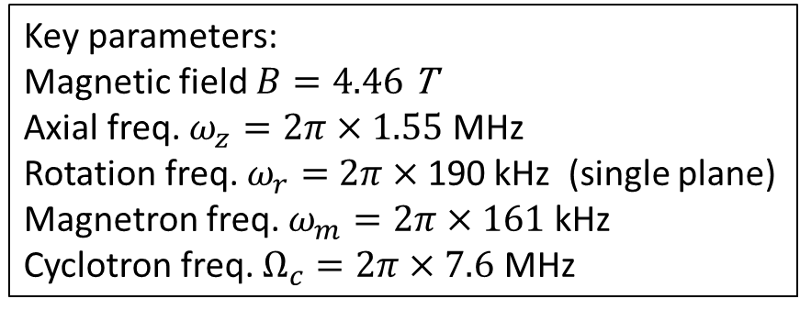

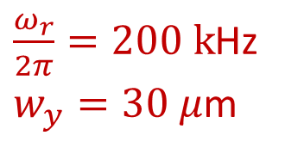
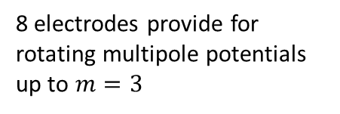
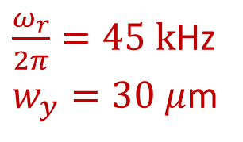
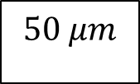
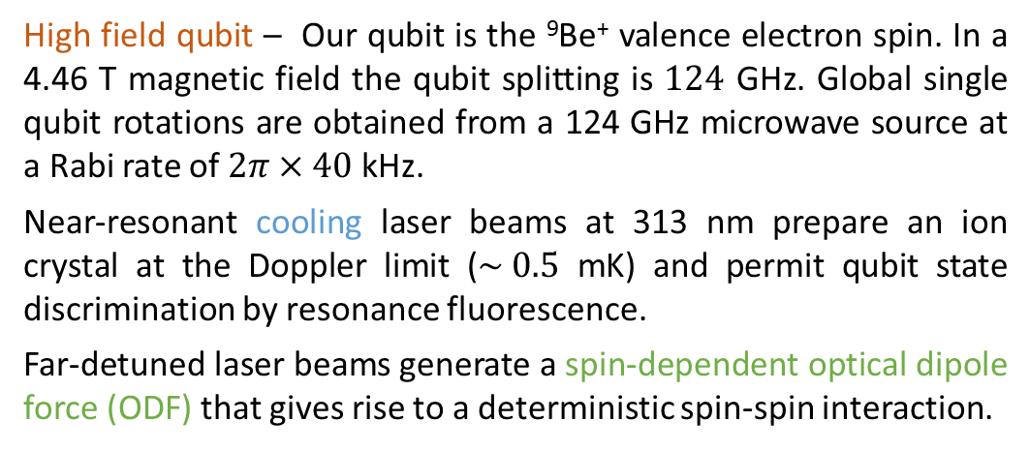
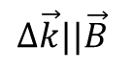
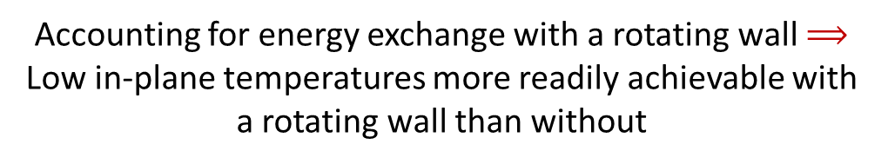
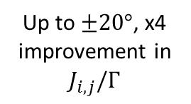
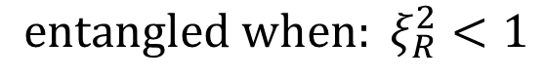
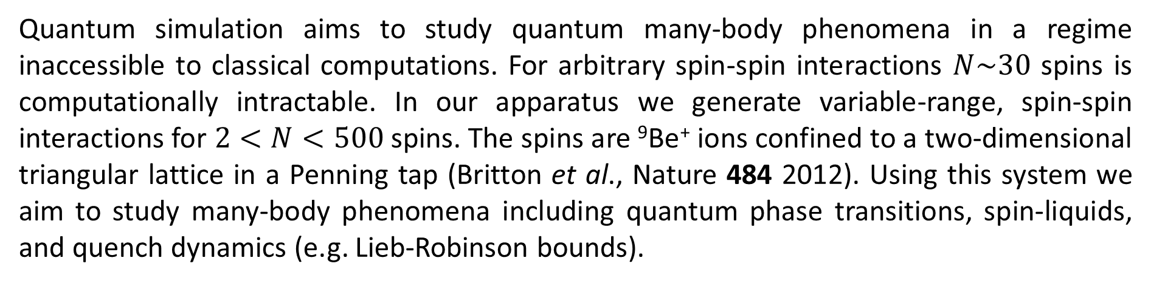
Motivation
Perpendicular laser cooling
with a rotating wall
Torrisi, Britton, Bohnet, Bollinger, PRA 93 (2016)
Spin squeezing and entanglement
Multiple quantum coherences
Quantum simulation aims to study quantum many-body phenomena in a regime inaccessible to classical computations. For arbitrary spin-spin interactions $N\sim 30$ spins is computationally intractable. In our apparatus we generate variable-range, spin-spin interactions for $2<N<500$ spins. The spins are ⁹Be⁺ ions confined to a two-dimensional triangular lattice in a Penning tap (Britton et al., Nature 484 2012). Using this system we aim to study many-body phenomena including quantum phase transitions, spin-liquids, and quench dynamics (e.g. Lieb-Robinson bounds).
Bohnet, et al, arXiv:1512.03756 to be published in Science
Benchmarking of quantum correlations and many-body physics in open quantum system.
Experimental measurement of Ising spin dynamics demonstrating entanglement by observing spin squeezing and acquiring full counting statistics. Examine interplay between correlations / entanglement and decoherence in open quantum system.
Probe coherence and entanglement of quantum states with many-body echos in the spirit of multiple quantum NMR.
Useful for benchmarking quantum simulators and studying dynamics of higher order correlations. Detect multiple quantum coherences (MQC) Im of ρ(τ ). We construct a lower bound on quantum Fisher information [need reference here to QFI] from the Im, the detection of multi-partite entanglement is possible, making the intensities an entanglement witness.
Advertise for Martin and Arghavan: thurs 11:06, 11:18 room 554AB Session N4
Accounting for energy exchange with a rotating wall $⟹$
Low in-plane temperatures more readily achievable with
a rotating wall than without
Experimental Details
Rotating wall provides an energy sink for the work done
by the perp beam in applying a torque
2-d geometry for
perp laser cooling
Experiment pulse sequence, composed of cooling laser pulses (blue), microwave pulses (grey), and ODF laser pulses (green).
Lab frame CCD images
Observe depolarization of the collective spin.
Distinguish destruction of correlations caused by decoherence from coherent depolarization caused by spin-spin interaction.
Side view
Contours of equilibrium temperature (mK) with
a color plot of the perp laser torque (Joules)
Coherent Interactions
$$100 μm$$
Bottom view
$$50 μm$$
$\frac{ω_{r}}{2π}=45 k$Hz
$w_{y}=30 μ$m
Decoherence
Experimental pulse sequence for measuring the multiple quantum coherence spectrum. The Bloch spheres
illustrate the evolution of the state. In the case of φ = 0 (blue) the spins return to the
initial state, while for φ = π/2 (green) the overlap of the final state ρf with the initial state is small.
(b) Fidelity signal for and idealized case with N = 6 spins for different evolution times τ . (c) The Fourier
transforms of the fidelity signals of (b). The Fourier amplitudes are identical with the multiple quantum
coherences Im, which quantify the coherence of the state ρ(τ ). The small squares on the right show the
absolute values of the density matrix elements of ρ(τ ) in the basis of symmetric Dicke states. Thus,
Im is the sum of the squares of all matrix elements at a distance m from the diagonal.
Rotating frame from timed single photon counts
Key parameters:
Magnetic field $B=4.46$ T
Axial freq. $ω_{z}=2π×1.55$ MHz
Rotation freq. $ω_{r}=$ $2π×$190 kHz (single plane)
Magnetron freq. $ω_{m}=2π×161$ kHz
Cyclotron freq. $Ω_{c}=2π×7.6$ MHz
$\frac{ω_{r}}{2π}=200 k$Hz
$w_{y}=30 μ$m
Depolarization of the collective spin from spin-spin interactions and decoherence. Coherent Ising interactions gives rise to over-squeezed state (top left), while decoherence leads to shortening of Bloch vector (bottom left).
Plot: contrast versus interaction time for N = 21, 58, and 144 ions indicated by black circles, red squares, and blue diamonds, respectively. Solid lines are predictions with no free parameters, including decoherence from spontaneous emission. The contrast decay from decoherence due to spontaneous emission is measured in the absence of spin-spin coupling (black squares with the dashed line showing an exponential fit).
⁹Be⁺ qubit system
Ising interaction with spin-dependent force
High field qubit – Our qubit is the ⁹Be⁺ valence electron spin. In a 4.46 T magnetic field the qubit splitting is $124$ GHz. Global single qubit rotations are obtained from a 124 GHz microwave source at a Rabi rate of $2π×40$ kHz.
Near-resonant cooling laser beams at 313 nm prepare an ion crystal at the Doppler limit ($\sim 0.5$ mK) and permit qubit state discrimination by resonance fluorescence.
Far-detuned laser beams generate a spin-dependent optical dipole force (ODF) that gives rise to a deterministic spin-spin interaction.
Two far-detuned laser beams produce a spin-dependent optical dipole force (ODF) at the ions that give rise to a spin-spin interaction. Combined with a transverse magnetic field, we can realize non-trivial quantum magnetic interactions.
Measure modification of collective spin variance
and verify entanglement using spin-squeezing.
transverse B-field from
124 GHz microwaves
Coupling to different axial modes allows for a tunable interaction range
a) Dependence of the normalized component hSzi of the total spin on the rotation angle φ. (b) Fourier
amplitudes of hSzi(φ) as a function of time. Note that for each instant of time the interaction strength J is
different since it has to be adjusted for τ to match the first decoupling point.
Coherence time
Engineered Ising interaction from
spin-dependent ODF
Fringe Contrast
$$Δ\vec{k}||\vec{B}$$
Up to $±20°$, x4 improvement in $J_{i,j}/Γ$
Spin variance as function of tomography angle and interaction time for N = 86 ± 2. The solid lines are a prediction, with no free parameters, assuming homogenous Ising interactions and including decoherence from spontaneous emission. The dashed lines are theoretical predictions with the same interaction parameters but no decoherence. The explicit time dependence of the spin variance. The data for the minimum (green points) and maximum (black points) spin variance are shown with theory predictions of the optimal squeezing and anti-squeezing (solid lines), including decoherence.
Controlling few-ion 2D crystals with rotating potentials
Britton et al., arXiv_1512.00801, to be published in PRA
$$ξ_{R}^{2}=N\frac{\min_{ψ}[(ΔS_{ψ})^{2}]}{|\vec{\left\langle S\right\rangle }|^{2}}$$
Add something about Michael Wall’s work here. Advertise his talk: thurs 11:30 554AB N4
$${entangled when: ξ}_{R}^{2}<1$$
Observe non-Gaussian counting statistics in collective spin state.
Disappearance of spin-squeezing at long times consistent with formation of over-squeezed state - not just degradation due to decoherence.
We apply a controlled torque to the ion crystal using a weak ‘rotating wall’ potential. This radially asymmetric potential is produced using split ring electrodes at the axial trap center. Controlling the rotation frequency stabilizes the radial trapping potential, producing stable ions crystals in a well-defined rotating frame.
Bloch sphere background / rotating frame
- pedagogy ? I found this confusing initially… Might help to explain later stuff
8 electrodes provide for rotating multipole potentials up to $m=3$
Future Directions
Transverse magnetic field
Apply sub-Doppler cooling (EIT) to the axial drumhead modes
$50 μm$
Images of different single-plane crystals in the rotating frame.
Composed of data from 1-2 seconds of integration.
Full counting statistics of a non-Gaussian spin state and theoretical Fisher information. Histograms showing
the (A) squeezed and (B) anti-squeezed quadratures of the collective spin of N = 127 ± 4 ions.

